Slide 1
Welcome
To our presentation

Slide 2
Bangabandhu Sheikh Mujibur Rahman
17 March 1920-15 August 1975
He is called the “Father of the Nation “
He is considered to be the driving force behind the independence of Bangladesh .
He is popularly dubbed with the title of "Bangabandhu" by the people of Bangladesh.
he outlined a six-point autonomy plan and was jailed by the regime of Field Marshal Ayub Khan for treason.
Sheikh Mujibur Rahman led the Awami League to win the first democratic election of Pakistan in 1970. Despite gaining a majority, the League was not invited by the ruling military junta to form a government.
Mujib indirectly announced independence of Bangladesh during a landmark speech on 7 March 1971. On 26 March 1971

Slide 3
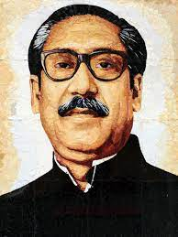
After Bangladesh's independence, Mujib was released from Pakistani custody due to international pressure and returned to Dhaka in January 1972 after a short visit to Britain and India.
Bangabandhu Sheikh Mujib and most of his family were killed during the early hours of 15 August 1975, when a group of young Bangladesh Army personnel went into his residence.
15 August is celebrated as a National Mourning Day in Bangladesh.

Slide 4
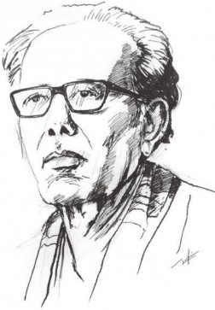
Zainul Abedin
Zainul Abedin (29 December 1914 – 28 May 1976) was a Bangladeshi painter born in Kishoregonj,East Bengal, British India (now Bangladesh).
He became well known in 1944 through his series of paintings depicting some of the great famines in Bengal during its British colonial period.
His homeland honored him with given the title “Shilpacharya” “Great teacher of the arts" for his artistic and visionary attributes.
He was the pioneer of the modern art movement that took place in Bangladesh and was rightly considered by Syed Manzoorul Islam as the founding father of Bangladeshi modern arts, soon after Bangladesh earned the status of an independent republic.
he helped to establish the Institute of Arts and Crafts (now Faculty of Fine Arts) at University of Dhaka.

Slide 5
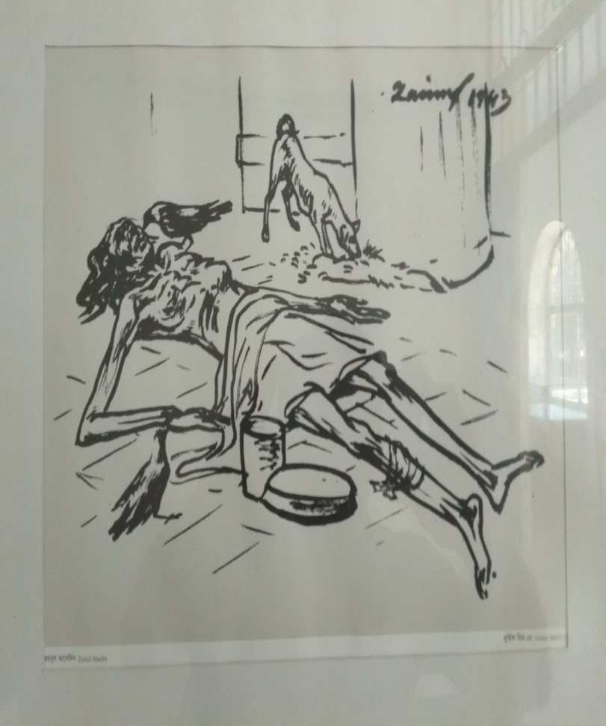
Among all the contemporary works of Abedin, his famine sketches of the 1940s are his most remarkable works. His famine painting set which, exhibited in 1944, brought him even more critical acclaim. The miserable situation of the starving people during the Great Famine of Bengal in 1943 touched his heart.
He depicted those starving people who were dying by the road-side.
He developed lung cancer and died on 28 May 1976 in Dhaka. Two faces was his last painting, completed shortly before his death.
He was buried beside the Dhaka University Central Mosque

Slide 6
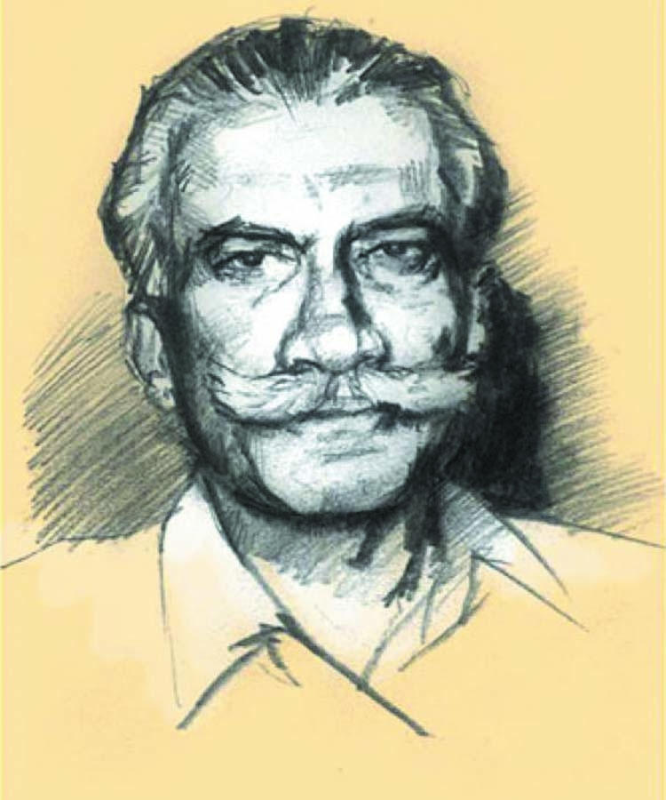
Muhammad Ataul Goni Osmani
Muhammad Ataul Goni Osmani (1 September 1918 – 16 February 1984), also known as Bongobir (the Hero of Bengal), was a Bengali military leader. He served as Commander-in-chief of Bangladesh Forces during the 1971 Bangladesh War of Independence.
Osmani entered politics in independent Bangladesh, serving as a member of parliament and cabinet minister in the government of Sheikh Mujibur Rahman.
In 1983, at age 65, Osmani was diagnosed with cancer and He died on 16 February 1984.

Slide 7
Sources :
1.https://en.wikipedia.org/wiki/Sheikh_Mujibur_Rahman
2. https://en.wikipedia.org/wiki/Zainul_Abedin
3. https://en.wikipedia.org/wiki/M._A._G._Osmani

Slide 8
Thank You

